Slide 1

Highest paid athletes
Top 10(2011-2021)
Project By: Mohammed Khizar M

Slide 2
Introduction
Forbes is one of the most popular business magazines!! It contains countless articles on numerous subjects (e.g., business, investing, technology, entrepreneurship, etc.), reporting valuable data and insights.
Forbes publishes annual lists on various topics. One such list is published for the top highest paid individuals in sports.
This study is used to unravel valuable insights about the top highest paid athletes from the year 2011-2021(11 Years).

Slide 3
Content:
The data are scrapped manually from Forbes articles listing the top 10 highest-paid athletes in tennis, NBA, and soccer.
Athletes can have multiple sources of income. • Team sports athletes earn a salary paid by their team whereas individual sports athletes compete in tournaments for prize money (such as tennis players). • Most of the time, brands are paying athletes to promote their products (on and off the court) as a marketing promotional strategy to reach a wider target audience and boost their sales / profit.
The dataset contains 11 years of data starting from 2011.

Slide 4
Problem Statements
• Which sport rewarded its athletes the most in each year? • Is there a trend across years for the total earnings of the top 10 highest-paid athletes of each sport? • Does this trend change when looking into salaries (or prize money) and endorsements separately? • Which country 'earns' the most out of those three sports each year?
These are examples of interesting questions that could be answered by analysing this dataset.

Slide 5
Total Earnings Of Athletes

Slide 6
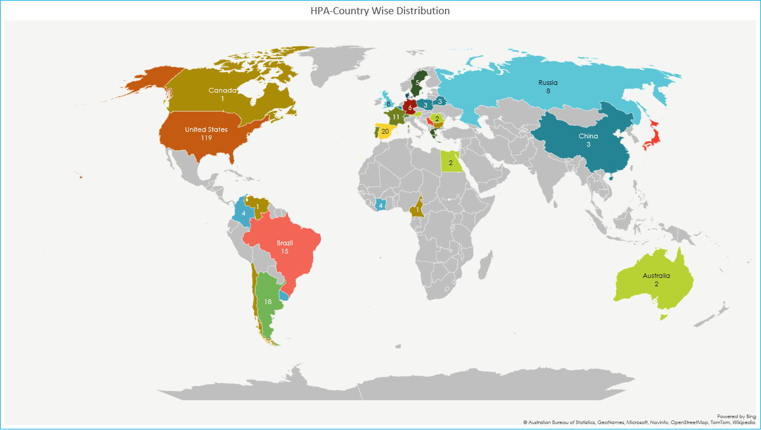

Slide 7
Percentage wise classification

Slide 11
Salary/Prize Money Trend

Slide 12
Endorsements Trend

Slide 13
Summary
To summarize the study of the given data set, we can state that the total earning of the top ten highest paid athletes has grown every year, with the exception of tennis in 2017,2018 and 2021.
Also, the salary has a steady growth in the 21st century over all sports competitions.
Similar to the salaries, endorsements has experienced a constant rise during the last decade.
The video having the detailed explanation of the project is attached below:
https://drive.google.com/file/d/12SeNtYxyVfKIUWUxPml9lI5PJA4SY7d7/view?usp=sharing
The excel file containing the detailed analysis can be found over here:
https://docs.google.com/spreadsheets/d/1_D3LquQaEVG9sU6UH7KxW4G-qLpOekkP/edit?usp=sharing&ouid=115445069647587616692&rtpof=true&sd=true

Slide 14
Conclusion
Based on the study we can conclude that each sport category has experienced as steady growth in terms of salary or prize money and endorsement over the period of 11 years from 2011-2021.
We can also state the most number of athletes earning their spot in the highest paid list of Forbes, come from United States of America.

